Slide 1
Welcome to... GCSE Maths and English Exams Information Evening

Slide 2
EXAM DATES:
GCSE MATHS
THURSDAY 16th MAY- Paper 1 Non-Calculator
MONDAY 3rd JUNE- Paper 2 Calculator
MONDAY 10th JUNE- Paper 3 Calculator
GCSE ENGLISH
THURSDAY 23rd MAY- Paper 1
THURSDAY 6TH JUNE- Paper 2
Notes:
55% know the exam dates
Asked when are the exam dates?

Slide 3
AWARDING BODIES
GCSE MATHS
AQA GCSE Mathematics 8700F (Foundation Tier)
Learners can achieve up to a grade 5.
GCSE ENGLISH
Pearson Edexcel (9-1) English Language 2.0
Learners can achieve up to a grade 9.
A grade 4 is a ‘standard’ pass.
Notes:
All know that their young people are studying F Tier.
55% of learners study both E&M

Slide 4
YIPIYAP & ADDITIONAL SUPPORT
Learners can access Yipiyap On Demand
Face to face Yipiyap sessions are available in the Success Centre
Revision sessions are planned for both Easter break and May half-term.

Slide 5
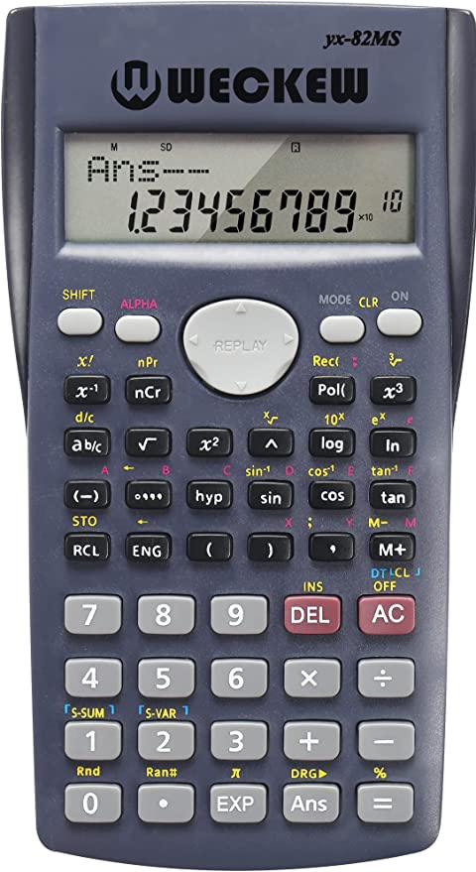
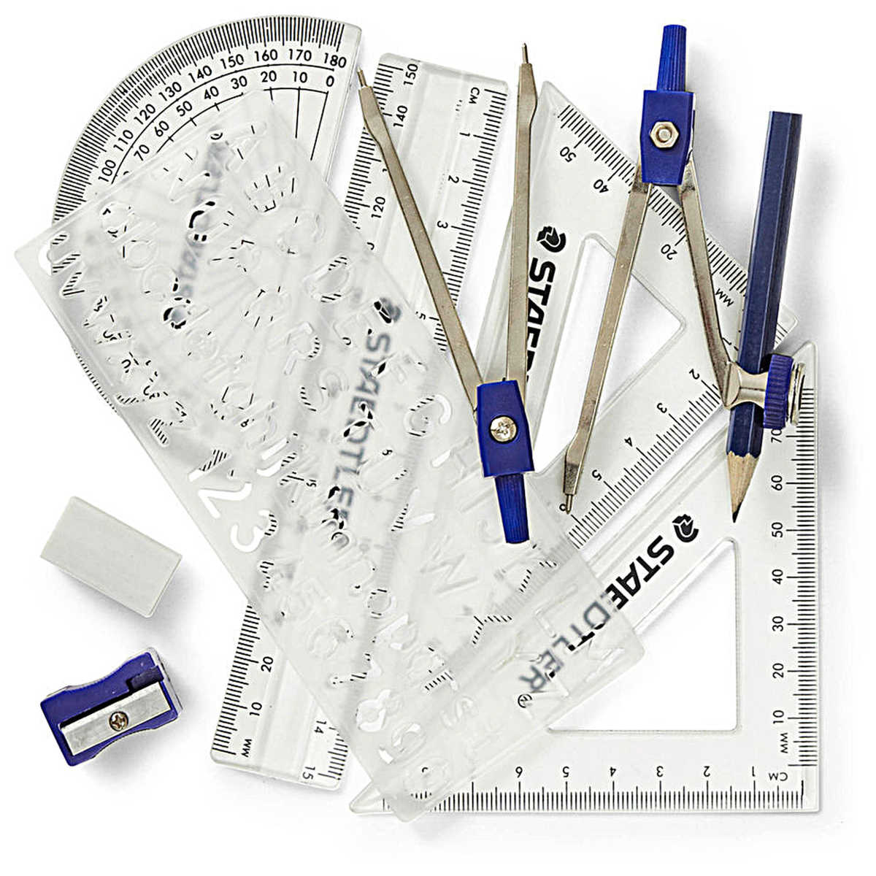
GCSE MATHS
DURATION-1 hour 30 mins per exam paper
EQUIPMENT- require a scientific calculator and a maths set and ID/lanyard
FORMULA SHEET- JCQ and the awarding bodies have agreed to a provide a formula sheet for the summer 2024 series of mathematics exams.
https://filestore.aqa.org.uk/resources/mathematics/AQA-8300F-FS-INS-2024.PDF
Notes:
70% own a calculator

Slide 6
GCSE ENGLISH
DURATION- 1hour 55 mins per exam paper
EQUIPMENT- Pen (black ink), highlighter (optional) and ID/lanyard
Paper 1-Non- Fiction Texts
19th century non-fiction extracts and transactional writing task.
Paper 2-Contemporary Texts
20th-21st century fiction and literary non-fiction and imaginative writing task.
Notes:
64% know what equipment is required-across all responses.

Slide 7
EXAM DAYS
ALL EXAMS are in the morning.
The majority of learners will be in the Sports Halls.
Learners need to register between 8-8:30AM at a room given to them by their personal tutors and curriculum areas.
Breakfast (toast and juice) will be available in key locations between 7:45-8:15AM on the morning of each GCSE exam.
English and maths staff will be at the key locations to answer any last-minute questions.
If your son/daughter/young person is going to be absent on the day of an exam please contact college as soon as possible on the day, ensuring you speak to a member of our team.
NB. In some cases, we may be able to apply for special consideration for that exam. Relevant evidence may be required depending on the situation.

Slide 8
FAQs
What happens if I am ill on the day of the exam?
It would be expected that learners still come and complete exams even with mild/moderate illnesses such as coughs, colds etc.
If a learner is too ill to sit an exam, JCQ guidance states that a grade can still be issued for that qualification provided that at least one other component for that subject has been completed. This means at least one exam paper per subject. In order for this to occur a letter from a doctor who examined that learner on the day of the missed exam must be provided in evidence.
It is unlikely that any grade issued in these circumstances will be as high as if the full complement of exams has been sat. As such this is a last resort when students are seriously ill.

Slide 9
FAQs
What happens if we have booked a holiday on exam dates? Can they sit at a later date?
It is vitally important that learners are present for all exams wherever possible. There is NO opportunity to sit an exam paper at a later date if it is missed. Their grade will be calculated based on the marks gained in the remaining paper(s).
If I miss the exams, can I resit in November?
There is a college resit policy that allows learners within a certain number of marks of a grade 4 to retake. Can I do it again next year if I miss the exams?
If you are enrolled onto a study programme/course at college next year, then you will continue to study English/maths as part of this.
NB. If you are 19 as of 31st August 2024 you will not be automatically allowed to.

Slide 10
FAQs
When will we get the exam results?
Results day is Thursday 22nd August 2024.
Are you able to forecast a learner's potential result?
We do not forecast results. However, all learners complete a series of assessments in both maths and English throughout the year. These assessments will highlight any strengths and areas for improvement as well as giving a mark for that particular paper. Our minimum expectation would be a one grade improvement in a year. If you would like a more detailed picture of their current performance, then we have a Parents' Evening on site on Tuesday 26th March.
Are there any extra books or resources my child can access?
At college we have Yipiyap and Yipiyap On Demand. MathsWatch is also available to learners. There is also the Maths and English Success Centre that learners can come to for extra support.

Slide 11
FAQs
How do you help the children not to worry and get anxious?
We understand that we all react differently to high pressure situations. Therefore, we do several mock assessments throughout the year to mimic the exam situation. Learners can always speak with us and the pastoral team if their anxiety becomes unmanageable.
Are you aware my child has extra-time in exams. Has the exam SENCO let you know? Learners are asked about previous EAA and ALS at enrolment but do not automatically get EAA just because they had it at school.
English and maths teachers then carry out 'normal way of working' forms for those who need something additional to support them in exams, e.g., reader, extra-time, laptop. ALS also assess where appropriate and the exams department then apply for EAA.

Slide 12
General Information
Learners will receive a postcard prior to the exams with their seat number and room.
Learners must not have any personal electronic devices on their person during any exam. These include, but are not limited to, mobile phones, watches (of any kind) and earphones. The consequence of being found with such items in an exam will likely involve the disqualification from one or more exam papers.
Notes:
Asked when revision days are?

Slide 13
Contingency Days
We are optimistic the exams will run smoothly, however, every year the exam boards publish contingency sessions so exams can be rescheduled if any national incidents prevent an exam taking place. This year the final contingency day is Wednesday 26th June. A further two contingency afternoons have been allocated on Thursday 6th June and Thursday 13th June. As such, learners must remain available up until this date should any exams need to be rescheduled.

Slide 14
Thank you
claire.storer@blackburn.ac.uk

