Slide 1
Welcome to...
GCSE Maths and English
November Resit Information Event

Slide 2
EXAM DATES
GCSE MATHS
Paper 1 – Wednesday 5 November (non-calculator)
Paper 2 – Friday 7 November (calculator)
Paper 3 – Monday 10 November (calculator)
GCSE ENGLISH
Paper 1 – Tuesday 4 November
Paper 2 – Thursday 6 November
Notes:
55% know the exam dates
Asked when are the exam dates?

Slide 3
AWARDING BODIES
GCSE MATHS
Edexcel GCSE Mathematics 1MA1 (Foundation Tier)
Students can achieve up to a grade 5.
GCSE ENGLISH
AQA (9-1) English Language 8700
Students can achieve up to a grade 9.
A grade 4 is a ‘standard’ pass.
Notes:
All know that their young people are studying F Tier.
55% of students study both E&M

Slide 4
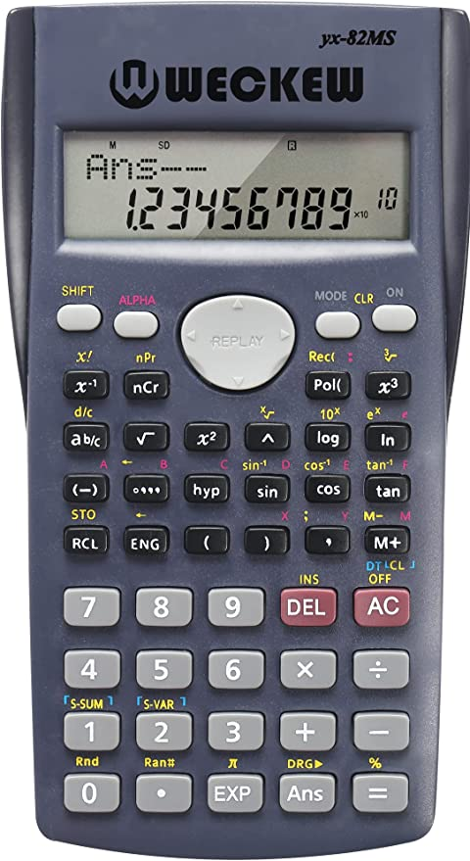

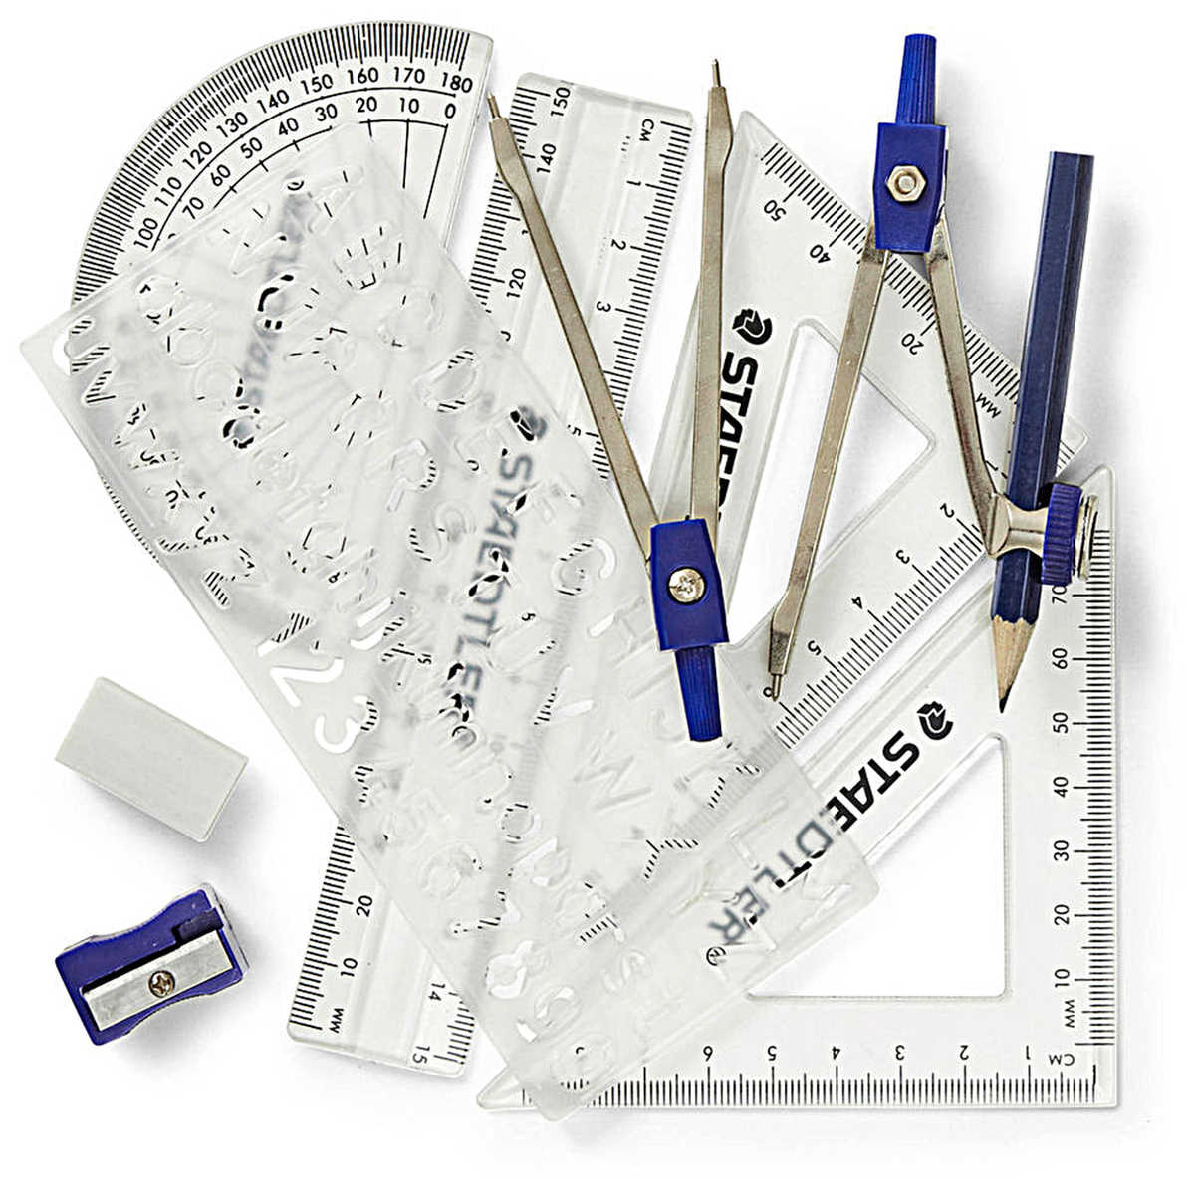
GCSE MATHS
DURATION: 1 hour 30 mins per exam paper
EQUIPMENT: a scientific calculator and a maths set (to be provided)and ID/lanyard
FORMULA SHEET: JCQ and the awarding bodies have agreed to a provide a formula sheet for the 2025 series of mathematics exams.
Mathematics Foundation tier Exam Aid
Notes:
70% own a calculator

Slide 5


GCSE ENGLISH
DURATION: 1hour 45 mins per exam paper
EQUIPMENT: Pen (black ink), highlighter (optional) and ID/lanyard
Paper 1: Explorations in Creative Reading and Writing
Paper 2: Writers' Viewpoints and Perspectives
Notes:
64% know what equipment is required-across all responses.

Slide 6
Expectations
We kindly ask for your support in encouraging them to:
Attend all classes and the weekly resit-specific class
Attend exam ‘Masterclass’ sessions w/c 13 October and 20 October
Access the half-term revision sessions
Complete all homework set
Prepare thoroughly for the exams
Should they fail to attend all sessions, then their entry for the November exams may be withdrawn.

Slide 7
The Success Centre
Additional support is available daily, Monday to Friday in the Success Centre, in the Beacon Centre Exchange.
All November resit students have been invited to attend a minimum of 1 additional session per week in the Success Centre. Attendance to this session is tracked.
Revision sessions are planned for October half-term, Monday 27 October to Wednesday 29 October. All resit students must attend at least one day.

Slide 8
EXAM DAYS
All exams are in the morning.
Most students will be in the Sports Halls.
If your son/daughter/young person is going to be absent on the day of an exam please contact college as soon as possible on the day, ensuring you speak to a member of our team.
NB. In some cases, we may be able to apply for special consideration for that exam. Relevant evidence may be required depending on the situation.

Slide 9
FAQs
What happens if I am ill on the day of the exam?
It would be expected that students still come and complete exams even with mild/moderate illnesses such as coughs, colds etc.
If a student is too ill to sit an exam, JCQ guidance states that a grade can still be issued for that qualification provided that at least one other component for that subject has been completed. This means at least one exam paper per subject. In order for this to occur a letter from a doctor who examined that student on the day of the missed exam must be provided in evidence.
It is unlikely that any grade issued in these circumstances will be as high as if the full complement of exams has been sat. As such this is a last resort when students are seriously ill.

Slide 10
FAQs
When will we get the exam results?
Results day is Thursday 8 January 2026.
Are you able to forecast a student's potential result?
We do not forecast results. All those that have been entered for the November resit are either: within 15 marks of the grade boundary, if they are a returning student. If new to college, they have provided a raw score which we have used to check suitability.
Are there any extra books or resources my child can access?
At college we have a well-resourced Maths and English Success Centre that students can access for extra support. MathsWatch is also available to students studying GCSE Maths.

Slide 11
FAQs
What revision/extra work should they be doing?
Students should be attending any additional opportunity available to them:
Revision sessions run daily (all day).
Complete practice papers/questions at home.
Complete timed questions.
Act on feedback given and work on those topics/questions.
Ask staff for extra work.

Slide 12
FAQs
How do you help the children not to worry and get anxious?
We understand that we all react differently to high pressure situations. This feeling is common and completely usual. Students can always speak with us and the pastoral team if their anxiety becomes unmanageable.
Are you aware my child has extra-time in exams.
Students are asked about previous EAA and ALS at enrolment but do not automatically get EAA just because they had it at school.
Returning students: should already have what was in place for them last year.
New students: If they had EAA at school, we would need a copy of their form 8 or 9 from your school if you want to have the same EAA in the resit.
The deadline to return this is Monday 6 October 2025. This deadline can't be extended.
If unsure, please ask them to go to the ALS office situated on the first floor of the Beacon Centre.

Slide 13
General Information
Students will receive details prior to the exams with their seat number and room.
Students must not have any personal electronic devices on their person during any exam. These include, but are not limited to, mobile phones, watches (of any kind) and earphones. The consequence of being found with such items in an exam will likely involve the disqualification from one or more exam papers.
Notes:
Asked when revision days are?

Slide 14
Post-Exams
After the November Exams
Your child will continue to attend their Maths/English lessons until results are released in January. If a grade 4 is not achieved, we will work closely with them to prepare for the summer exam series, and lesson attendance will remain compulsory.
Results Day
The results day for the November exam series is:
Thursday 8 January 2026

Slide 15
Thank you
claire.storer@blackburn.ac.uk
sarah.barnard@blackburn.ac.uk

